Slide 1

STAT-S 650 Time Series Analysis
Daily Weather Humidity Forecasting
Satya Priyanka Ponduru

Slide 2
Data Set Overview and Variable Description
The dataset consists of daily weather data collected over a certain period.
Data Set is obtained from Kaggle.
Source: https://www.kaggle.com/datasets/apratik46/daily-weather-dataset
The dataset contains 1094 rows and 10 columns, and they are described below:
number: unique number for each row
air_pressure_9am: air pressure averaged over a period from 8:55am to 9:04am (Unit: hectopascals)
air_temp_9am: air temperature averaged over a period from 8:55am to 9:04am (Unit: degrees Fahrenheit)
air_wind_direction_9am: wind direction averaged over a period from 8:55am to 9:04am (Unit: degrees, with 0 means coming from the North, and increasing clockwise)

Slide 3
Variable Description(contd.)
air_wind_speed_9am: wind speed averaged over a period from 8:55am to 9:04am (Unit: miles per hour)
max_wind_direction_9am: wind gust direction averaged over a period from 8:55am to 9:10am (Unit: degrees, with 0 being North and increasing clockwise)
max_wind_speed_9am: wind gust speed averaged over a period from 8:55am to 9:04am (Unit: miles per hour)
rain_accumulation_9am: amount of rain accumulated in the 24 hours prior to 9am (Unit: millimeters)
rain_duration_9am: amount of time rain was recorded in the 24 hours prior to 9am (Unit: seconds)
relative_humidity_9am: relative humidity averaged over a period from 8:55am to 9:04am (Unit: percent)
relative_humidity_3pm: relative humidity averaged over a period from 2:55pm to 3:04pm (Unit: percent )

Slide 4
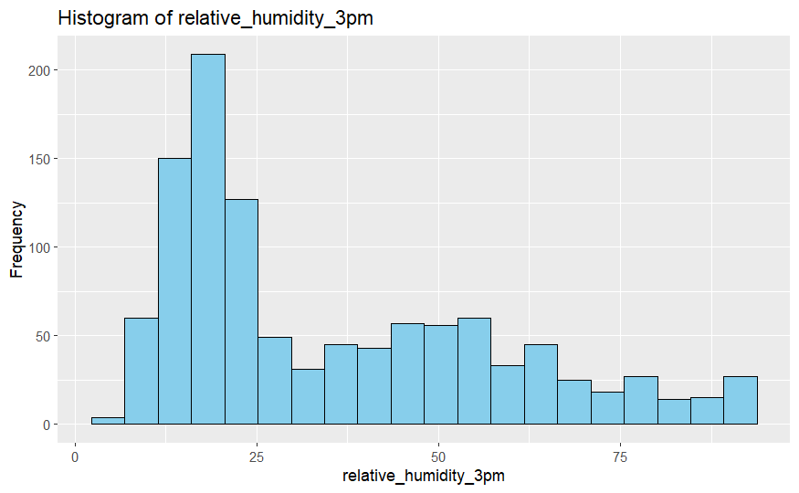
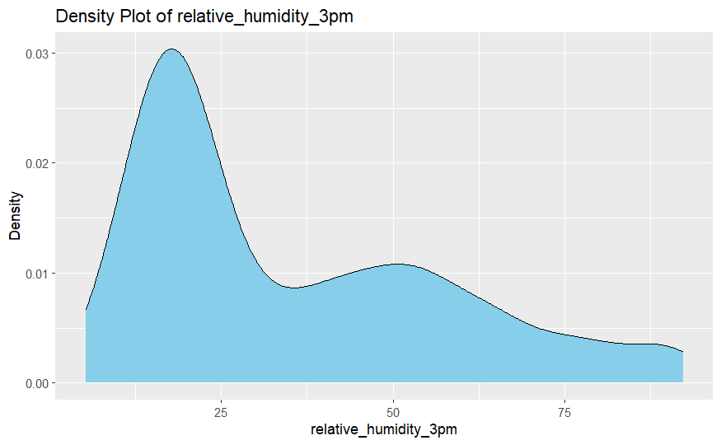
Histogram and Density Plots of Relative Humidity at 3pm

Slide 5
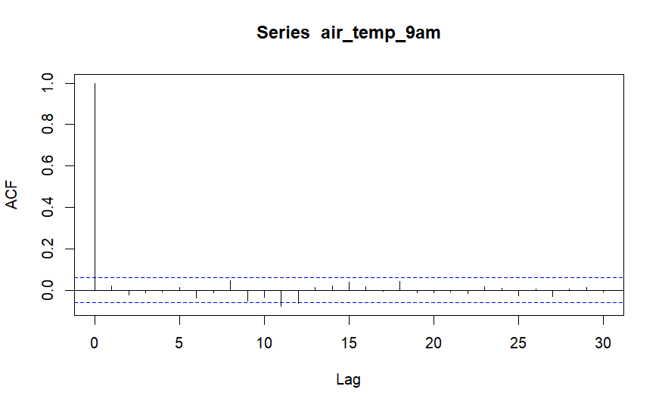
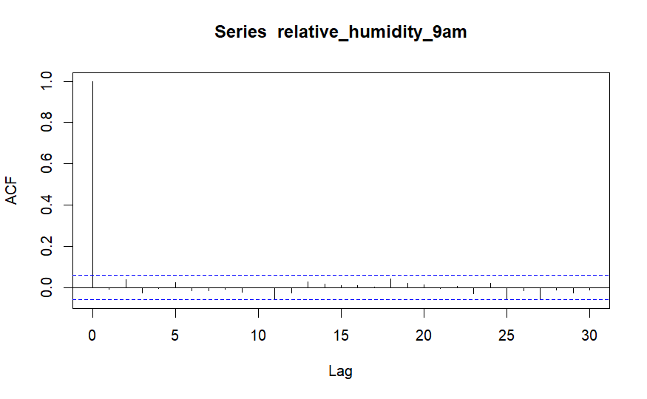
ACF Plots of Temperature at 9Am and Humidity at 3pm

Slide 6
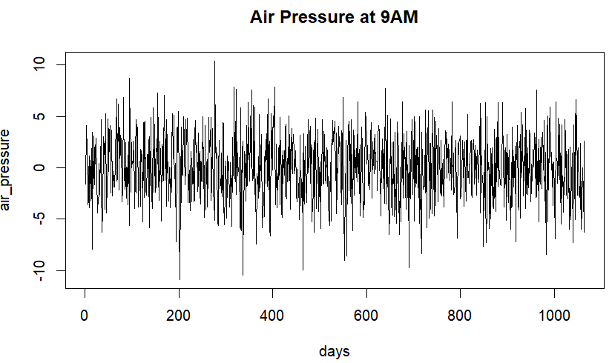
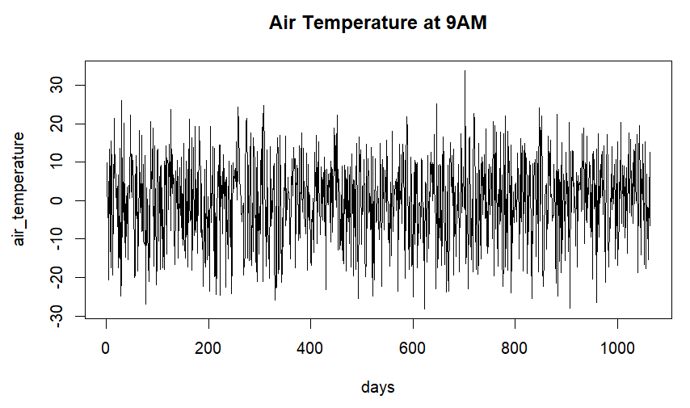
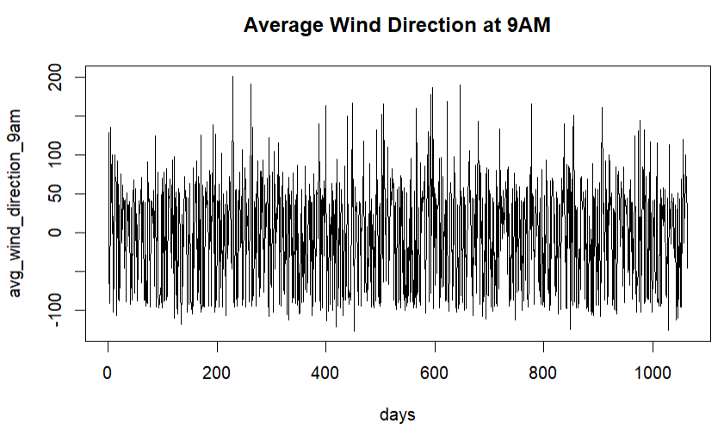
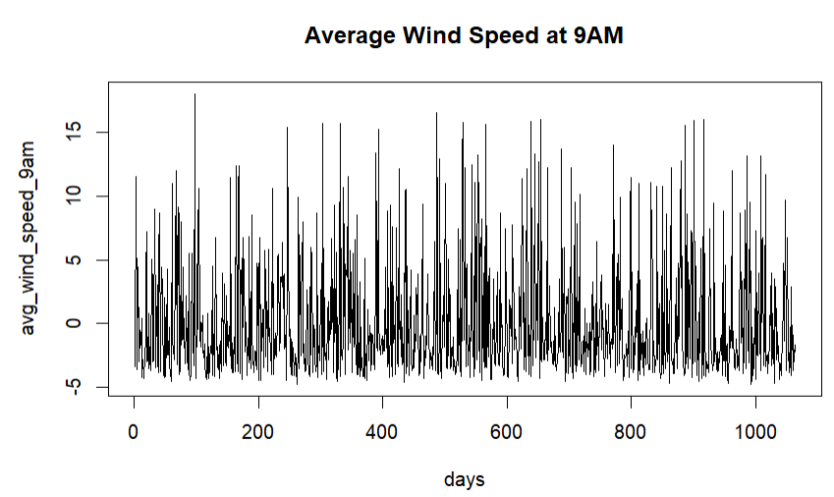
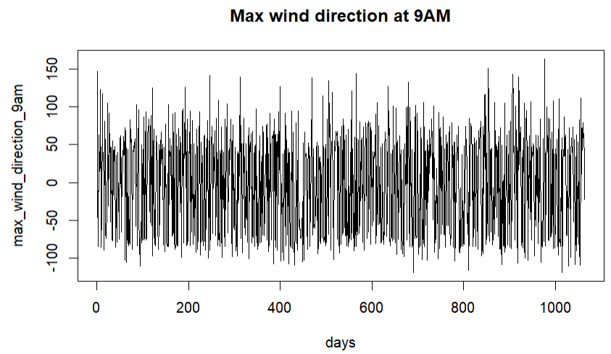
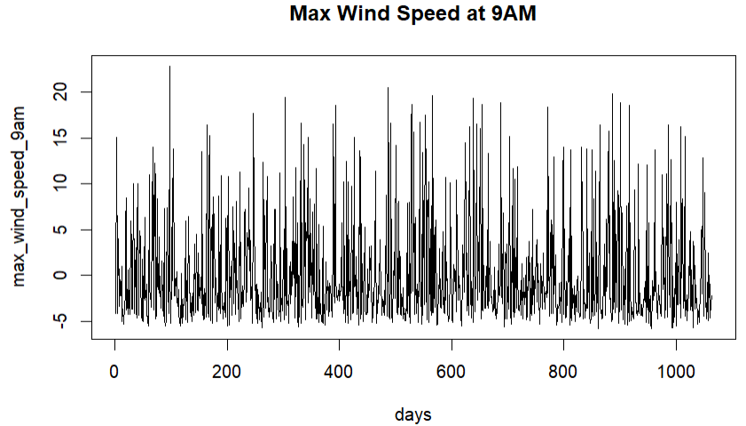
Time Series Plots

Slide 7
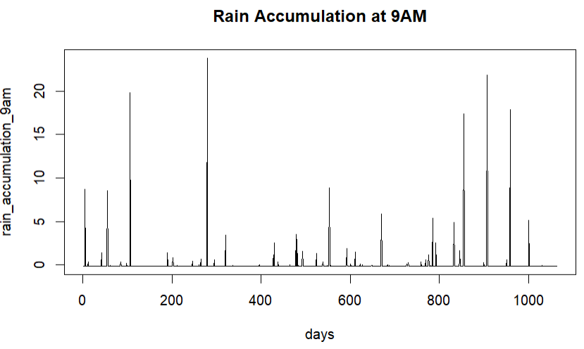
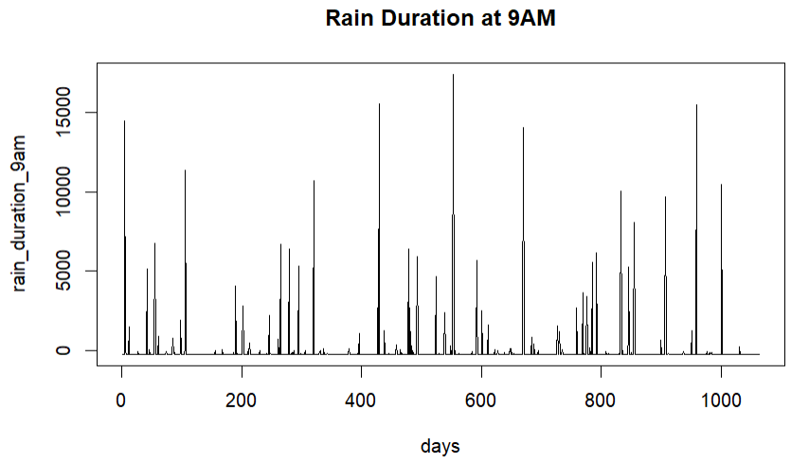
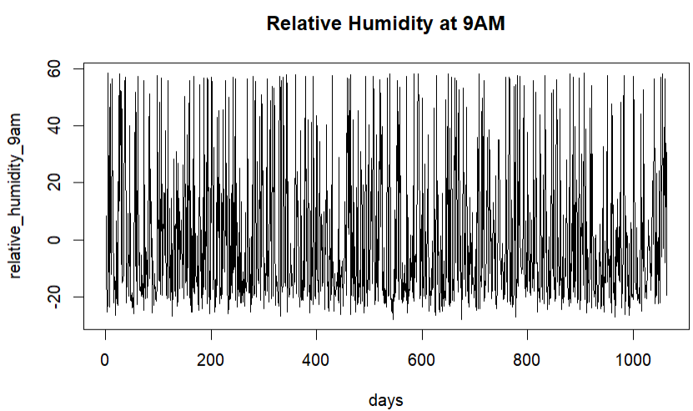
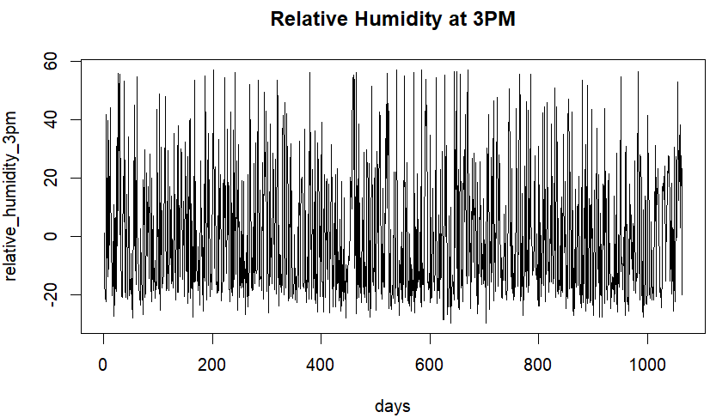
Time Series Plots(contd)

Slide 8
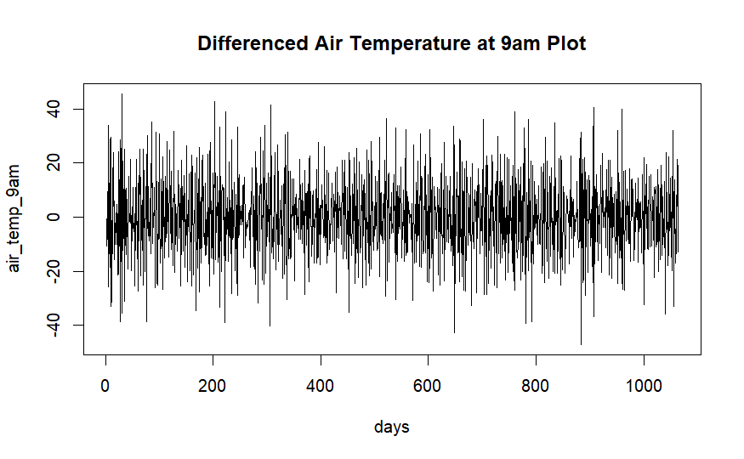
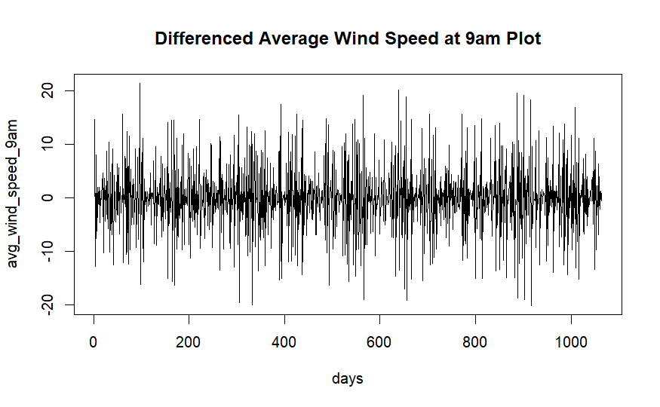
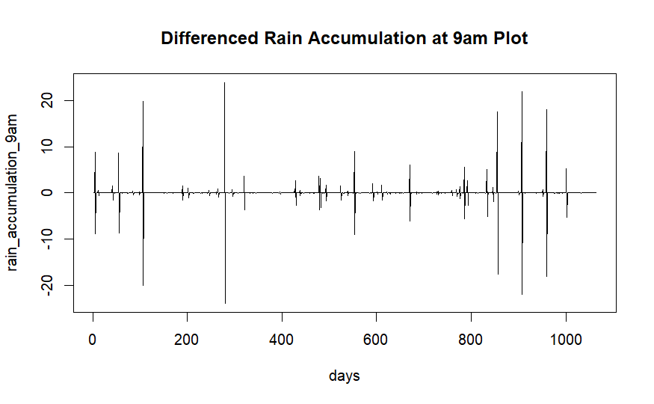
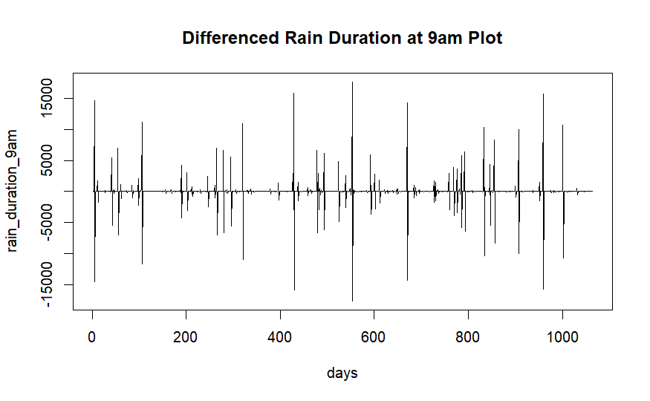
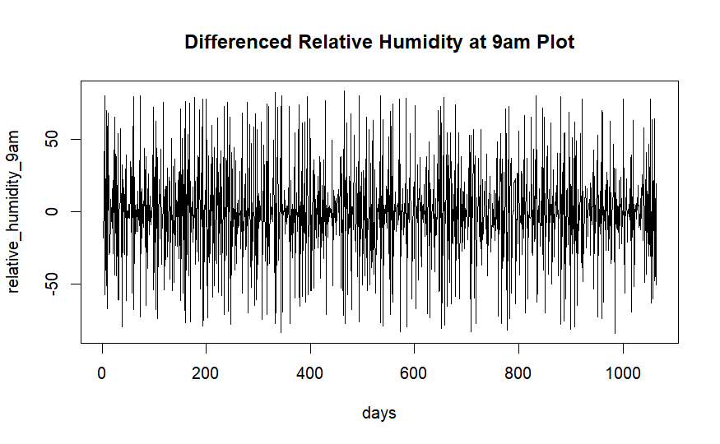

Plots After Differencing for Stability

Slide 9
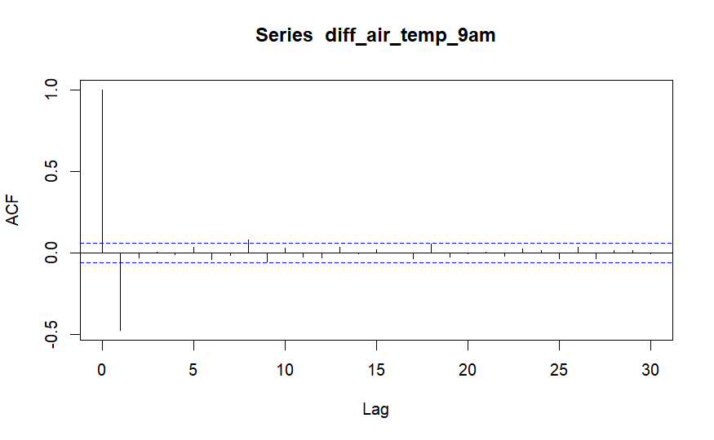
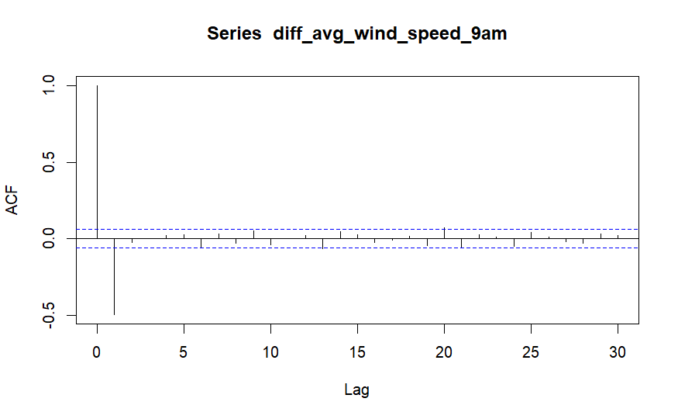
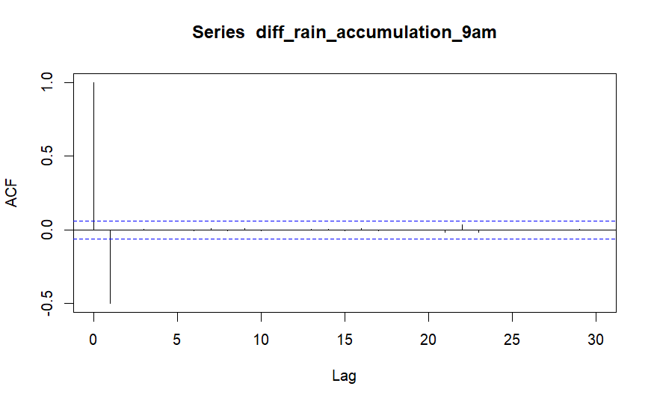
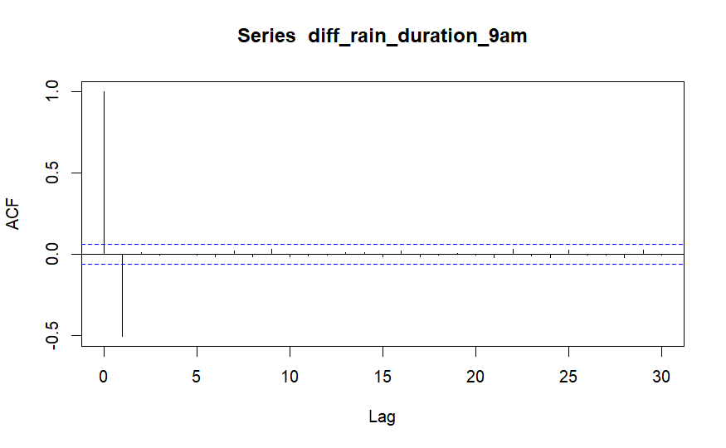
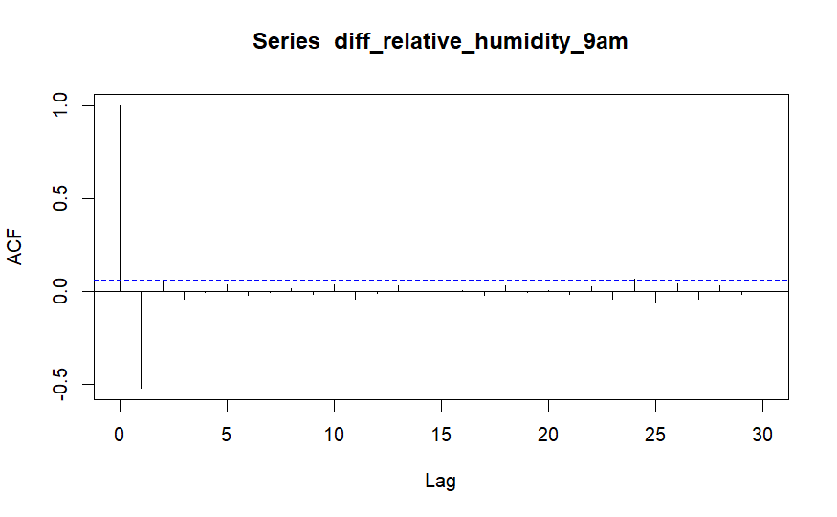

ACF Plots After Differencing

Slide 10
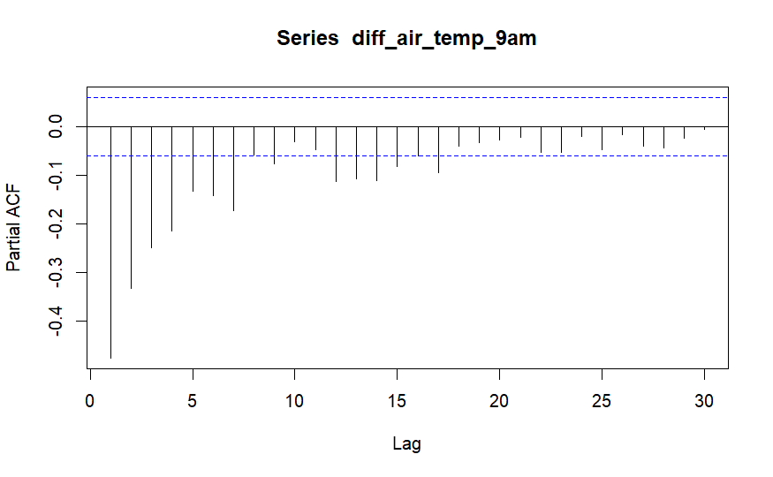
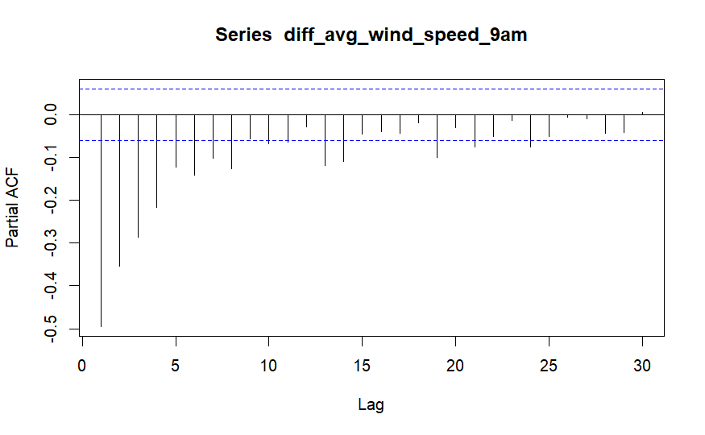
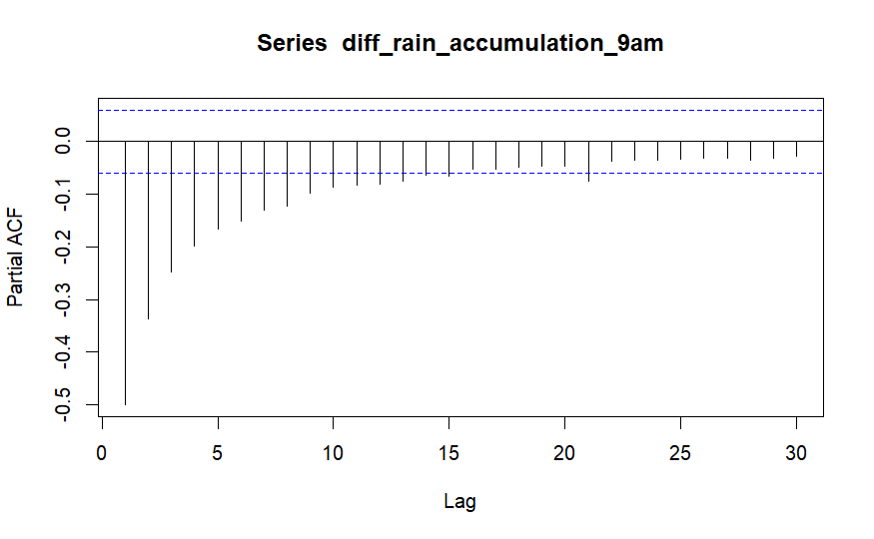
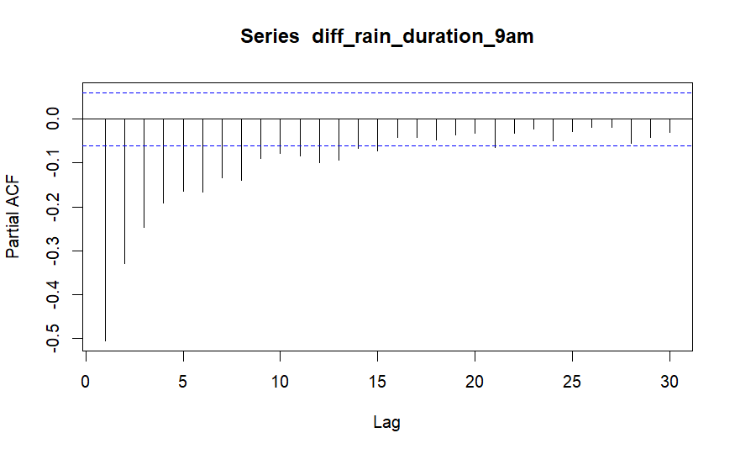
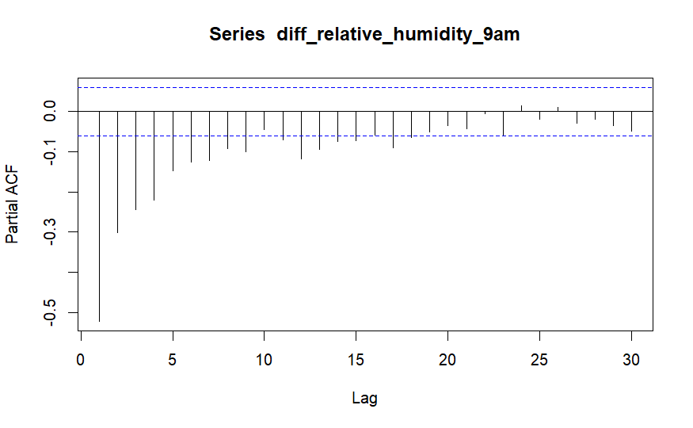
PACF Plots After Differencing

Slide 11
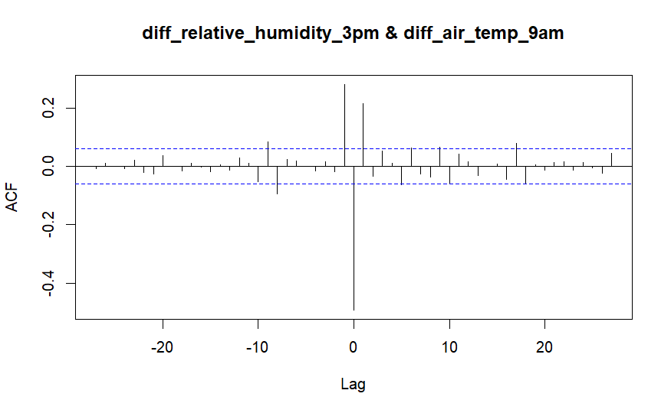
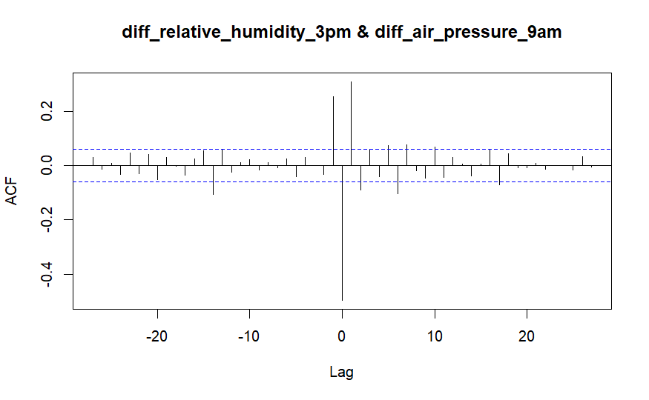
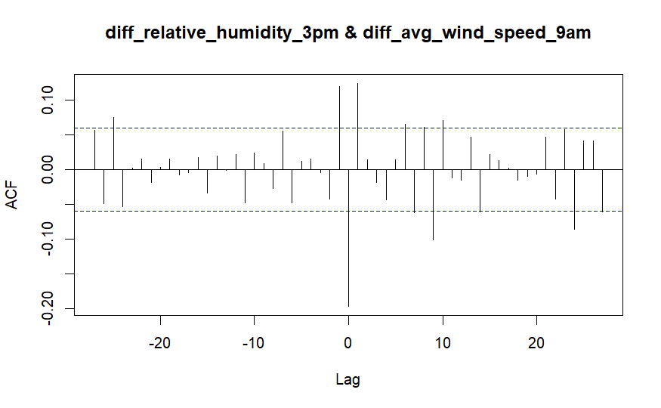
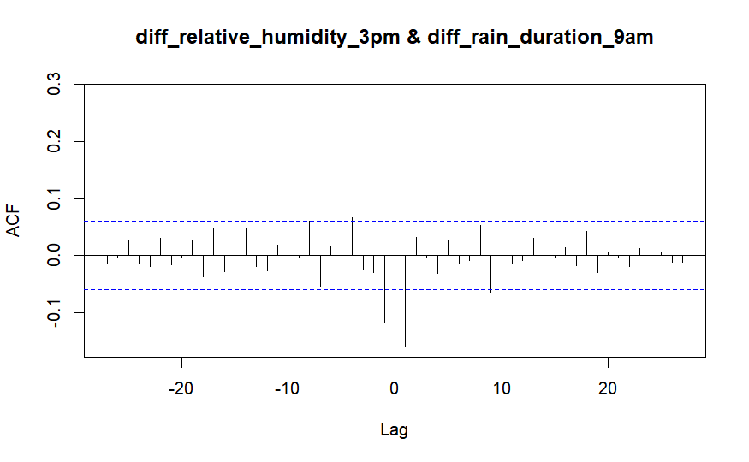
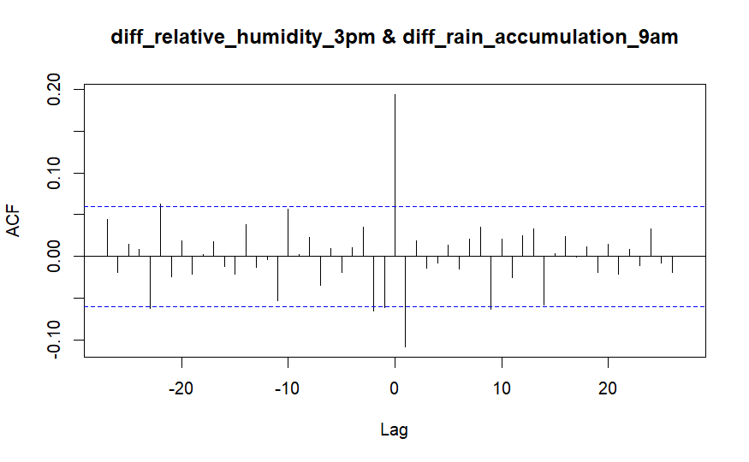
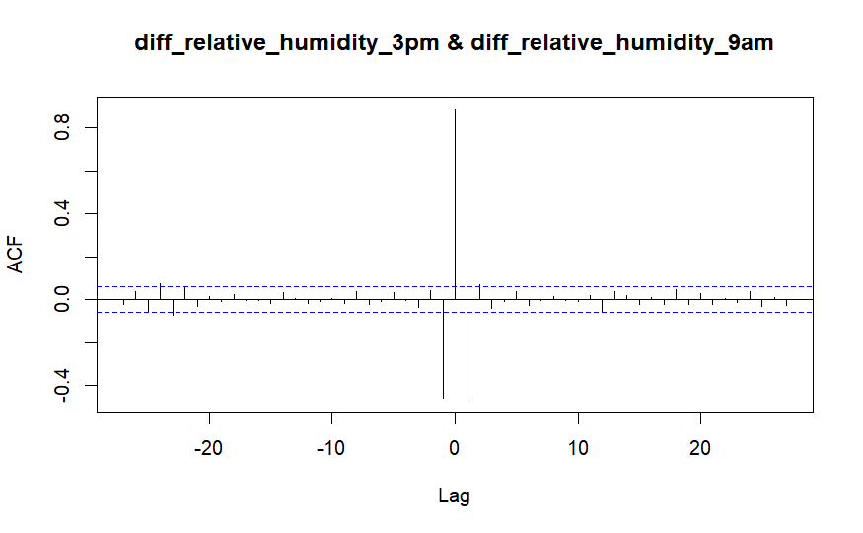
CCF Plots after Differencing

Slide 12
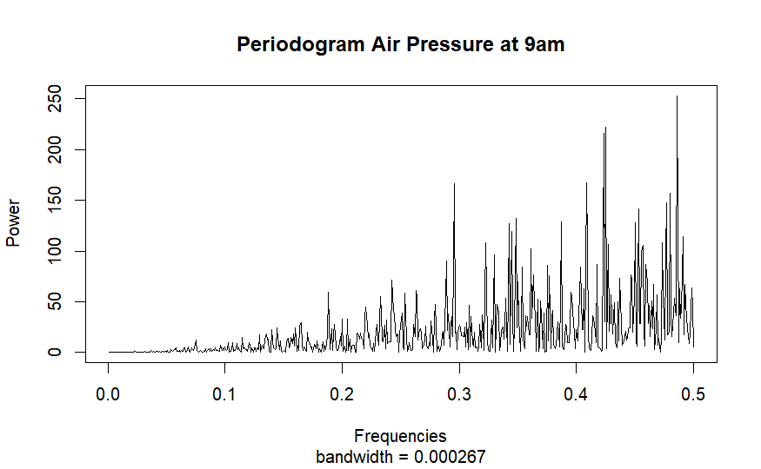
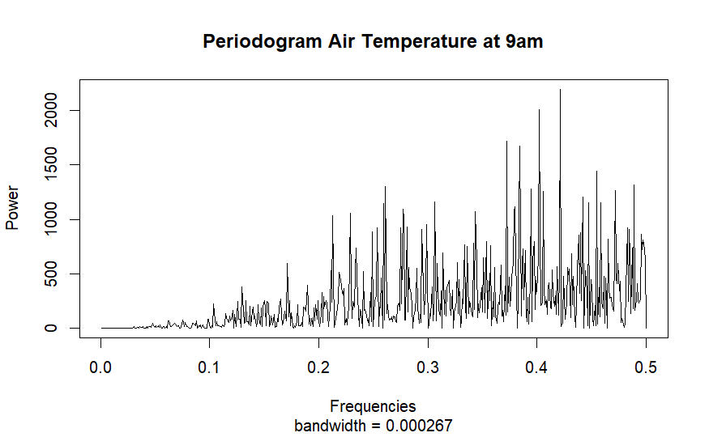
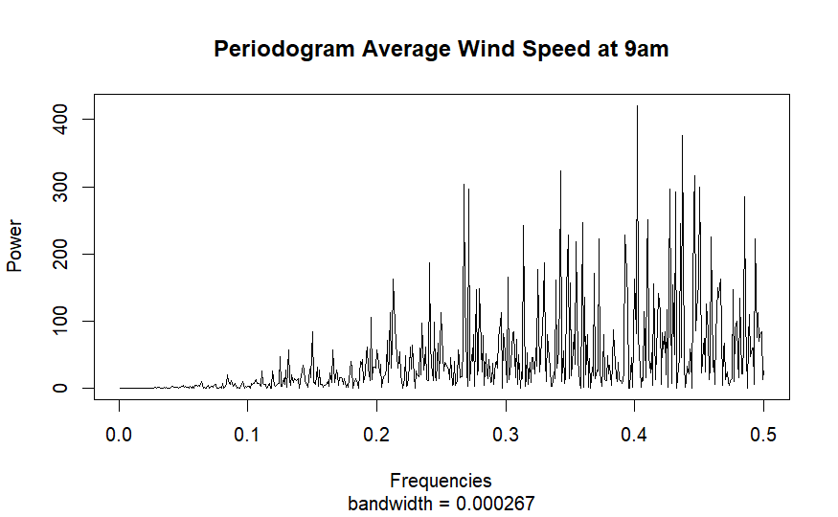
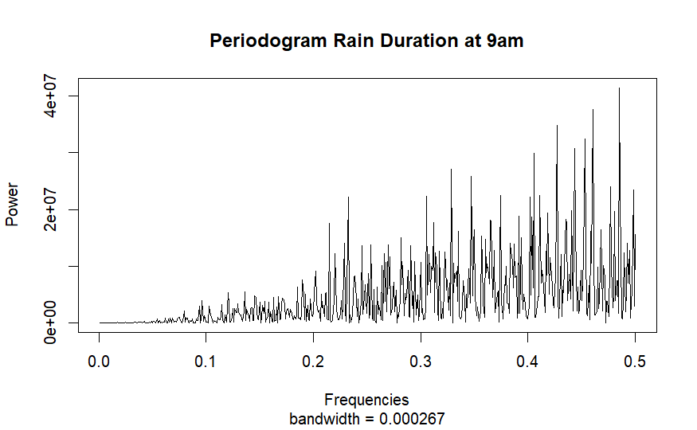
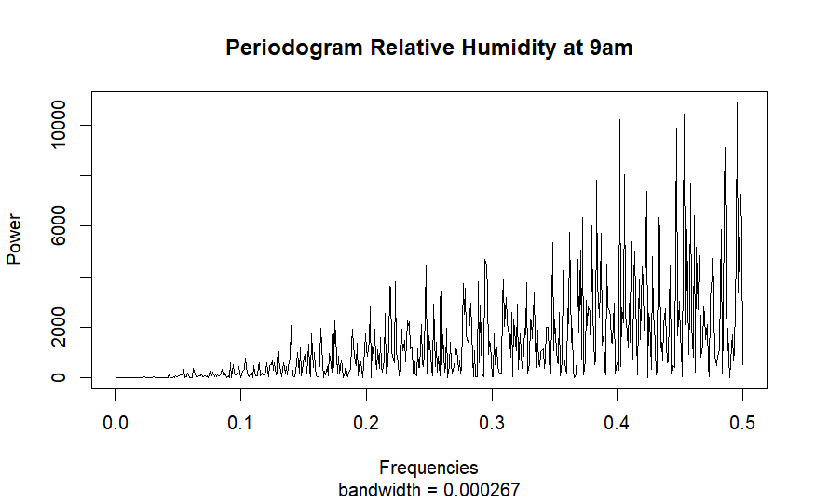
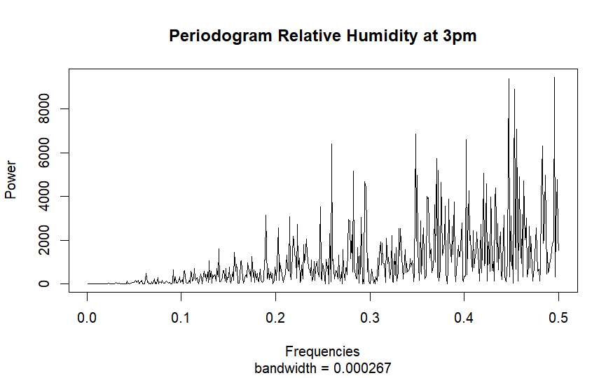
Spectral Analysis

Slide 13
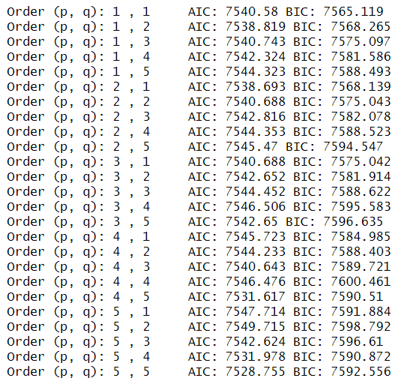
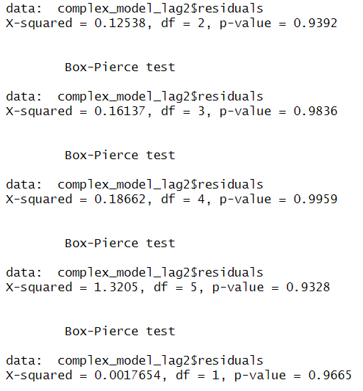
ARIMA Model Fitting

Slide 14
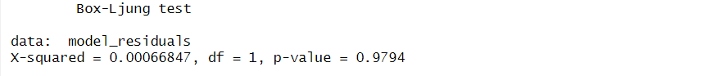
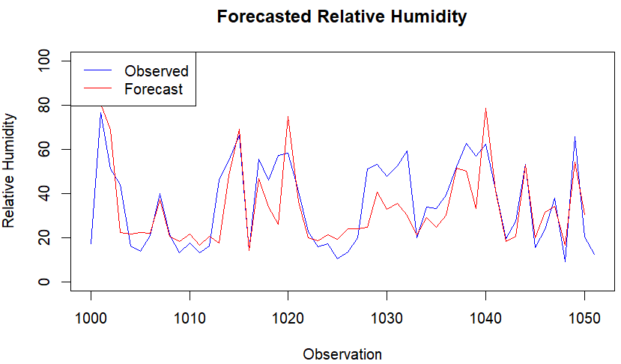
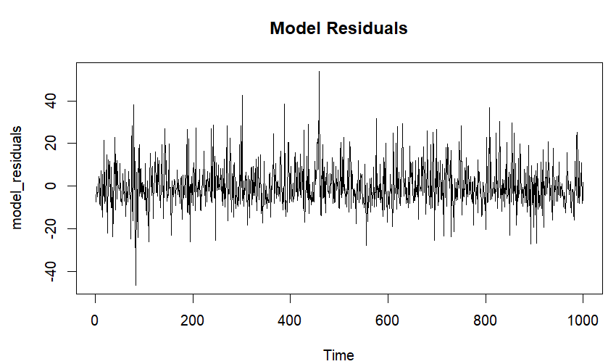
Best ARIMA Model

Slide 15
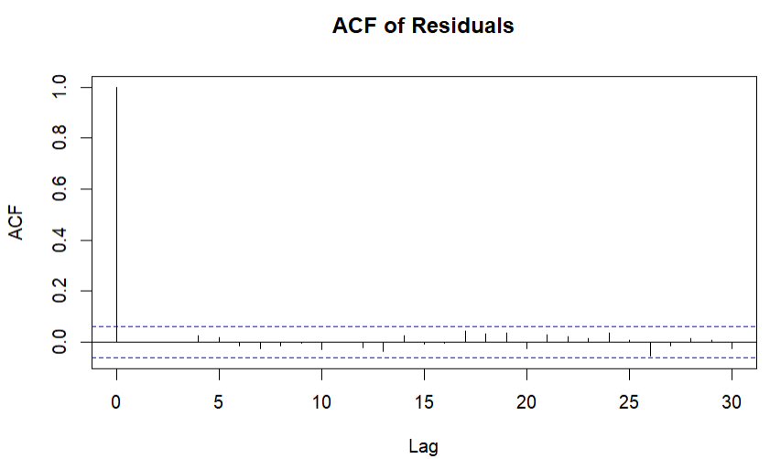
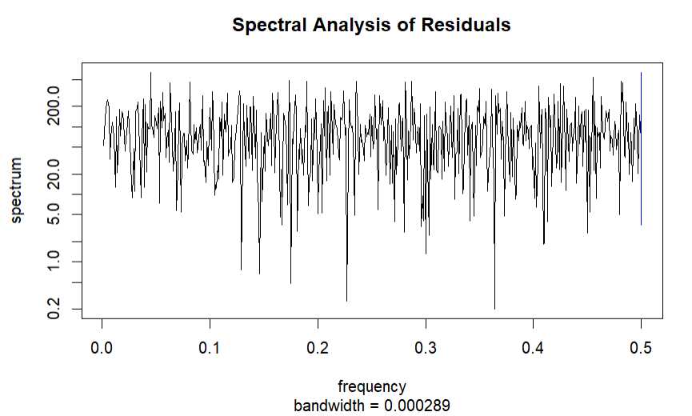
ACF and Spectral Analysis of Residuals

Slide 16
Conclusion
Arima(5,0,5) model is observed to be the best model with AIC: 7528 and BIC: 7592
The model has very low RMSE and MAE values on the training set, indicating good fit.
The test statistic corresponds to a p-value greater than 0.05, which means there is no significant evidence of autocorrelation in the residuals. This suggests the residuals are white noise.
Future Improvements: Build a Vector Autoregressive model for the data and compare performance of each.

